Slide 1

GoodNotes Take-Home Assignment
Flight Delay Prediction
August
2020

Slide 2

Thoughts about the problem

Slide 3
Delay Time
The claim amount is directly related to the delay time.
If the delay time of the flight is given, then the prediction is simple.

Slide 4
Delay Time
If the delay time is provided, there is no need to devise a machine learning solution since all that is required is a simple if-else check. If the flight is cancelled or the delay time is greater than 3 hours, the claim amount is 800. Otherwise, the claim amount is zero.
The model makes a simple prediction based on the claim rule if the delay time is provided in the test data set.

Slide 5
Delay Time
Since the goal is to predict the claim amount for future flights, it might be possible that the delay time is not known, and hence, the model must be able to make predictions without knowing the delay time.

Slide 6
Modeling the problem
In the training dataset, the only claim values present are 0 and 800.
Hence, the problem can be modeled either as a regression problem or a classification problem, each with its own pros and cons.

Slide 7
Modeling the problem
A regression model would most likely have a higher mean absolute error, but lower mean squared error.
A classification model would most likely have a lower mean absolute error and a higher mean squared error.
However, a classification model would lead to values that are too extreme (0 or 800).

Slide 8
Modeling the problem
The regression output is bound between 0 and 800, and hence, a classification model that outputs a sigmoid probability could also be used, by multiplying the output by 800.
The business objective is to obtain a claim amount based on the risk, so a classification model whose sigmoid output is multiplied by 800 or a regression model might both be suitable.

Slide 9
Analysis
The data was analyzed with a Jupyter notebook.
The data is imbalanced with far more claims of 0 than 800. Only about 4.38% of the claims have the value 800.
Number of unique airlines: 123
Number of unique arrival locations: 163
Number of unique flight numbers: 2344

Slide 10
Analysis
The flight ID is unique for each entry and will thus not be important for predictions.
All data samples have “HKG” for their “Departure” field.
All flight numbers begin with the two-letter code of the airline.
Each sample with the same flight number has the same arrival location and roughly the same departure time.

Slide 11
Approach

Slide 12
Data Preparation
The “flight_ID” field is removed from the data.
The “flight_no” field is removed from the data because it is directly related to the field “Arrival” and “Airline” fields.
The “flight_date” field can also be removed from the data set as it does not provide useful information for predictions. Trends that happen at a specific time of the year can be learned from the Week field, and trends that occur only on a specific day would be unlikely to help the predictions and may even lead to overfitting.
The “Departure” field is removed from the data.

Slide 13
Data Preparation
The departure hour is standardized by dividing the values by 23, so that the resulting values are in a range of 0 to 1.
The week number is standardized by subtracting it by 1, and dividing the value by 51, so that the resulting values are I the range of 0 to 1.

Slide 14
Data Preparation
One-hot encodings are created for the airline names and arrival locations, thus increasing the number of features.
When handling test data set, the columns of the training data and the testing data are aligned to match each other.
When evaluating the test set, it is possible that some airlines and arrival locations might not have been present in the training data.
For these values, the value of zero will be used in all the columns of the corresponding one-hot encoding in the testing data.

Slide 15
Model
Simple models like Linear Regression and SVM were used initially, but the performance was not satisfactory.
More complex models like artificial neural networks were attempted.

Slide 16
Model
The final model is a feedforward neural network with two hidden layers.
The ReLU activation function is used on the hidden layers, with a sigmoid activation function on the final output layer.
The dropout regularization technique is used.
The model is trained with gradient descent using the Adam optimization algorithm.
The model predictions are clipped to the range [0,800].

Slide 17
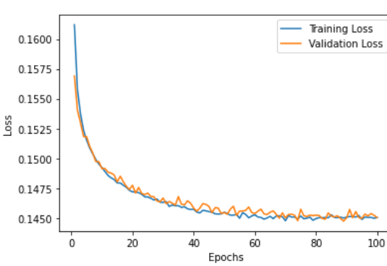
Model Loss (Cross-Entropy) over 100 epochs

Slide 18
Model Analysis
The validation loss is very similar to the training loss, so the model has low variance.
The bias of the model could probably be reduced, and deeper networks or more sophisticated network architectures might improve the model performance.
The last 10% of the training data is used for validation and is not used when training the model.
The Mean Absolute Error for the validation set is 59.88, and the Mean Squared Error for the validation set is 23157.94.

Slide 19
Next Steps
Improvements and additions if given more time

Slide 20
Dimensionality Reduction
The data has over 300 features due to the one-hot encodings.
This could be reduced by dimensionality reduction methods like PCA, which might help improve performance.
The dimensionality of the data could also be reduced by using binary encodings or label encodings instead of one-hot encodings.

Slide 21
Data Analysis
More thorough data analysis and visualization could be done if there was more time, which could lead to useful insights that could help in solving the problem.
More features could be constructed in order to aid the model in making better predictions.

Slide 22
Models
.
Simpler models like decision trees, and more complex neural network architectures could also be experimented with, in order to find the best performing model.
Cross-validation could be implemented.

Slide 23
Code Robustness
Extra care could be taken to make the code more robust.
Exceptions like invalid input could be handled more gracefully.

Slide 24

THANK YOU!
Romario Timothy Vaz
Phone
+852-81928759
Email
romario.vaz@gmail.com

